Slide 1


MEDVISION
AI
HealthTech & AI🥼🩺
Team: ElectronEdge
We are Team Electron Edge, and this is MedVision Our AI-powered solution for fast and accessible skin disease analysis. In the next few minutes, we’ll walk through the problem, our approach, and how MedVision creates real, practical impact.
Om Shinde
(Leader)
Mihir Mendake
Sanjay Kushwaha
Siddheshwar Hinge

Slide 2

PROBLEM
:
PROBLEM :
SKIN DISEASES AFFECT 1 IN 4 INDIANS — BUT ACCESS TO DERMATOLOGISTS IS LIMITED.
EVIDENCE :
SPECIALISTS CONCENTRATED IN METRO CITIES
Rural areas lack clinical access
People rely on Google → wrong guidance
Early symptoms ignored → become serious
Millions ignore early skin issues due to embarrassment or no dermatologist nearby. Late diagnosis leads to more severe conditions

Slide 3
SOLUTION
MedVision AI — a web-based assistant that detects common skin conditions using ML.
FAST
MedVision solves this with a simple flow: upload a skin photo → our ML model predicts the possible condition → we show clear do’s and don’ts in human-friendly language → and recommend a specialist based on the user’s location. The goal is not to replace doctors, but to guide people early and safely
SIMPLE
Accessible for everyone.
India has just 1 dermatologist per 100,000 people. Early detection can reduce severity, cost, and recovery time across all demographics

Slide 4
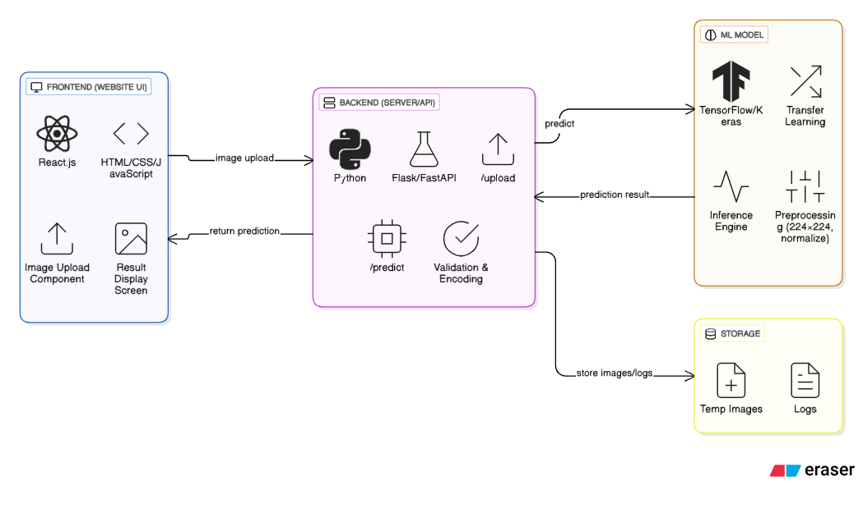
Tech stack
Tech Stack Overview
Our MVP is built using a clean, modular tech stack that ensures fast image upload, secure processing, and accurate ML predictions. The frontend collects the image, the backend handles preprocessing and model inference, and the database stores essential logs. This layered setup keeps the system lightweight, scalable, and ready for real-world deployment.

Slide 5

UNIQUENESS
Human-style explanations (plain language, not robotic)
Location-based dermatologist suggestions
Web-first → no app install
Expandable architecture (add more diseases easily)
LLM + CNN fusion → medical + conversational intelligence
PDF report for sharing with doctors
Most competitors only detect cancer we detect common everyday issues like rashes, fungal infections, acne, eczema.
✨Unlike general AI chatbots, ours is domain-specific — optimized for skin diseases, extremely fast, and lightweight enough to run even offline.

Slide 6
🤝‍💼Key Partners
🛠️Key Activities
🚀Value Proposition
👥Customer Segments
⚠️Problem Statement
Dermatologists & advisors
AI/ML engineers
Cloud platforms (AWS/GCP)
Hospitals & skin clinics
Health NGOs
Image dataset providers
Training the AI model
Dataset collection & verification
App development
Accuracy testing
Updating medical info
Ensuring security & privacy
Many people ignore early skin symptoms due to lack of awareness
Dermatologist access is limited or expensive in many areas.
Users want quick, trustworthy info without long clinic waits.
Instant skin disease detection from photo
Quick and accessible initial screening
Reduces fear with easy information
Helps users know when to see a doctor
Affordable and available 24/7
Individuals experiencing skin-related issues.
Students and young adults needing quick health information.
Dermatology clinics wanting AI-assisted screening
📡Channels
🔧Key Resources
🏆Competitive Advantage
💡Solution
Mobile app (primary platform).
Play Store / App Store listings.
Social media campaigns for awareness
Community health pages and college outreach.
🤝Customer Relationships
AI classification model
Labeled skin image dataset
App development team
Cloud servers
Medical content database
Brand & partnerships
Faster than visiting a clinic for initial check.
Easy-to-use interface with accurate predictions.
AI improves continuously with more data.
Provides quick education + risk awareness.
A user uploads a photo → AI identifies possible skin disease
Provides clear explanation + risk level + recommended action.
Helps users know whether to visit a doctor or not.
Completely self-service scanning feature.
AI-generated result with explanation.
In-app chat with support
💰Cost Structure
💵Revenue Streams
Cloud hosting and storage expenses. And App development & maintenance costs.
VDataset licensing or expansion costs.
Marketing, branding, and promotions.
Validation/testing with dermatologists.
In-app advertisements
Premium version (ad-free + extra features)
Subscription plans for advanced analysis
Clinic/doctor partnership integrations
Licensing AI model to health apps (long-term).
Our model is simple: free basic detection, premium dermatologist consultations, and B2B API for clinics and telemedicine platforms

Slide 7
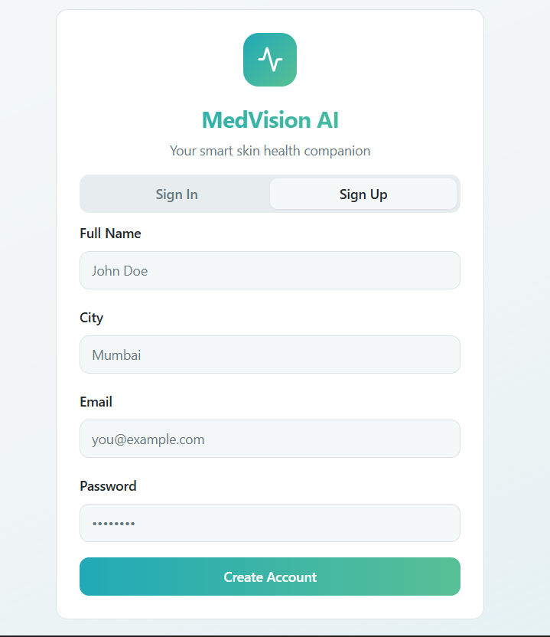
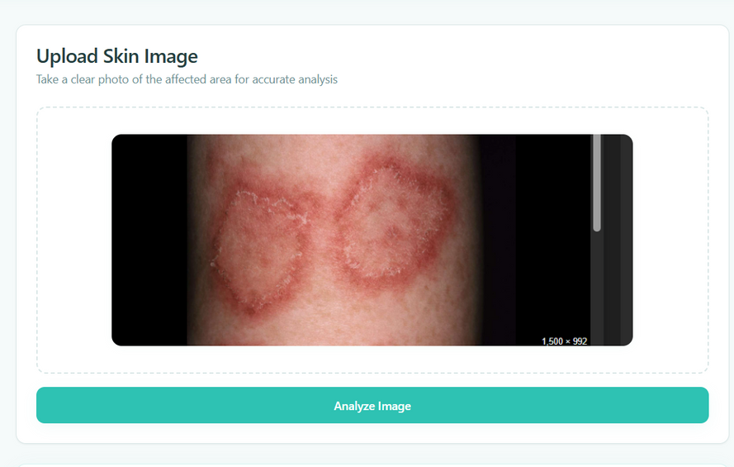
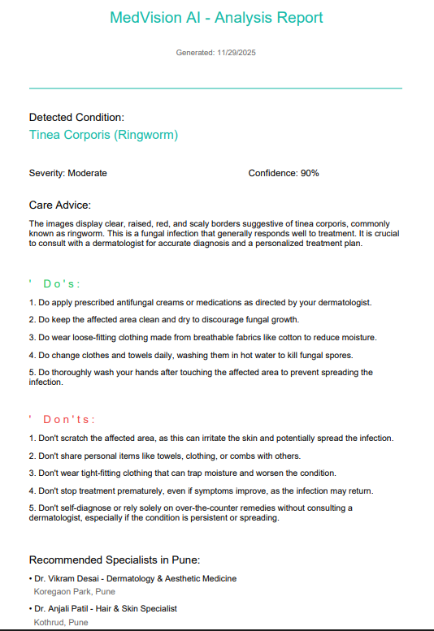
Prototype Screens
Let me walk you through a quick demo.
The user logs in with name and location → lands on the home page → uploads a skin photo → our ML model instantly analyses it → shows the predicted condition with simple do’s & don’ts → also gives dermatologist suggestions based on location → and finally, the user can download a clean PDF report. This is the full end-to-end experience.

Slide 8
MEDVISION
AI
Skin Health, Simplified
If this aligns with your vision, select MedVision for the next round — we’re ready to create something truly valuable
In short, MedVision is fast, practical, and built for real-world use. Our team is ready to take this prototype into a fully deployable product with your support.
We’re asking for one thing today the opportunity to move this idea forward and build a solution that genuinely helps people.
Thank you.

